Slide 1

Procesamiento de Imágenes
Domingo Mery
Departamento de Ciencia de la Computación
Escuela de Ingeniería
Universidad Católica de Chile
Image Restoration - Examples
[ Capítulo 6 ]

Slide 2
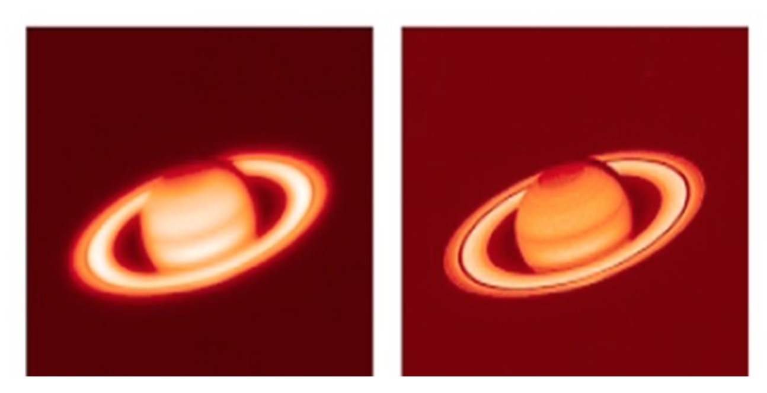

Slide 3
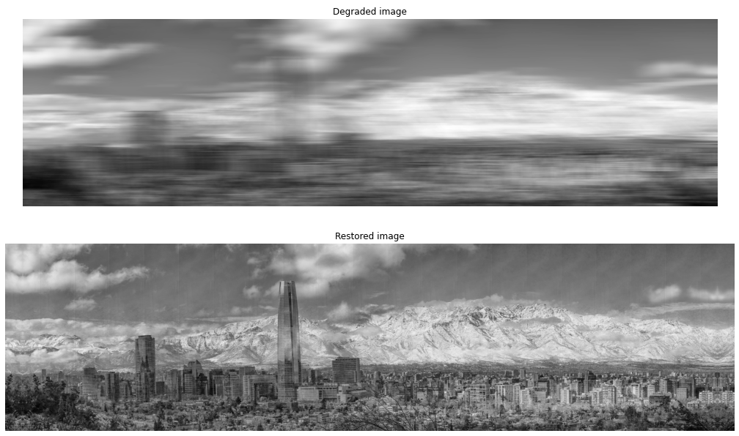

Slide 4


Slide 5
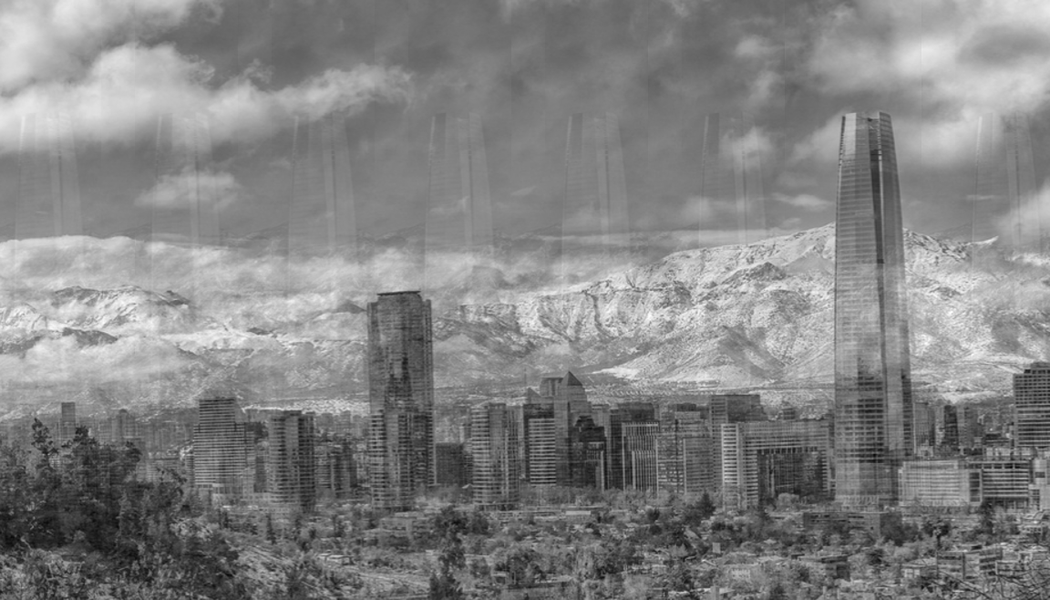

Slide 6
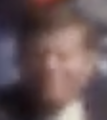
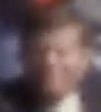

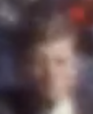
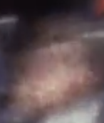
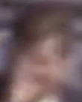
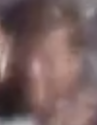
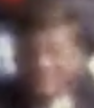

Who is he?
https://www.youtube.com/watch?v=PfSXkfV_mhA
https://www.youtube.com/watch?v=iU83R7rpXQY

Slide 7
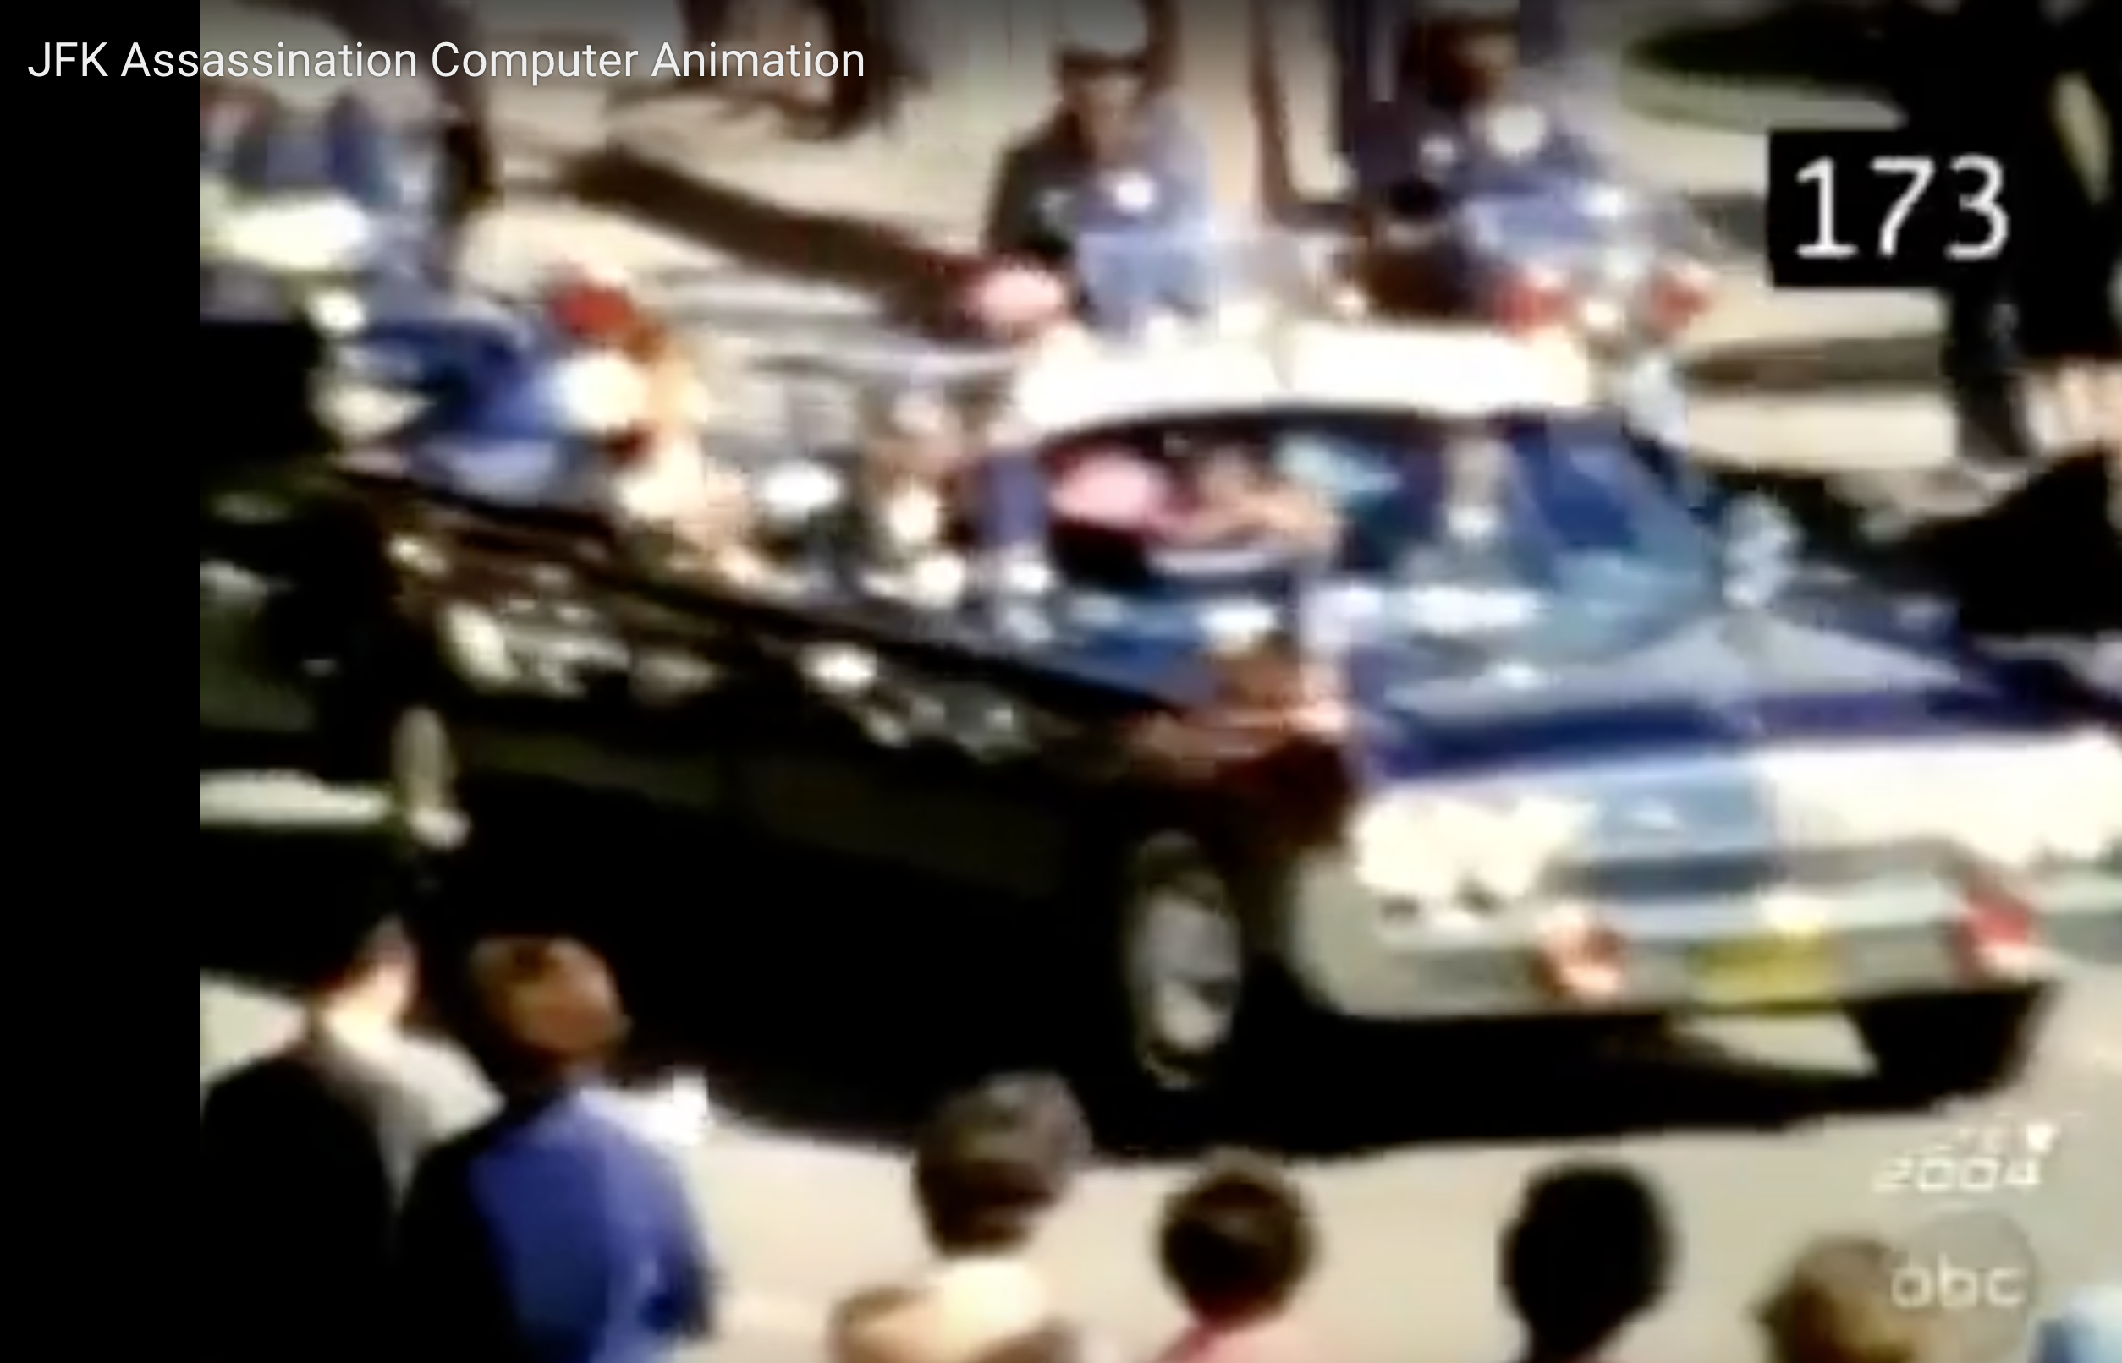
Notes:
https://www.youtube.com/watch?v=PfSXkfV_mhA
https://www.youtube.com/watch?v=iU83R7rpXQY

Slide 8
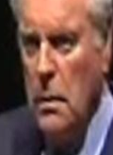

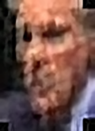
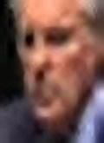

Slide 9
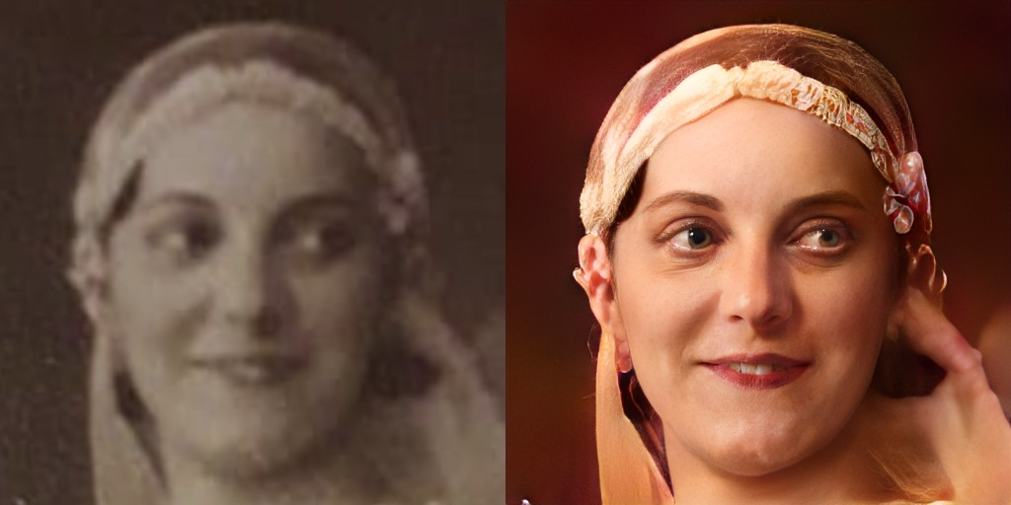

Slide 10

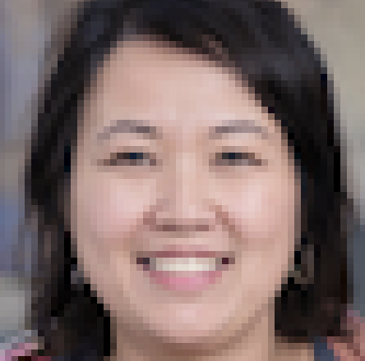
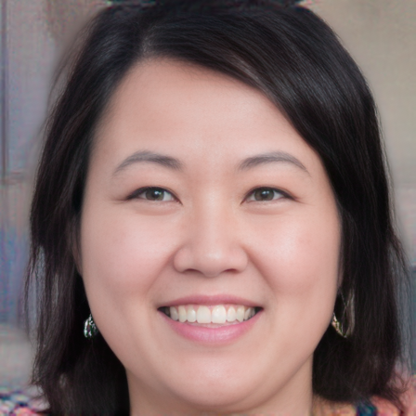

ORIGINAL
448x448
INPUT
56x56
OUTPUT
448x448

Slide 11
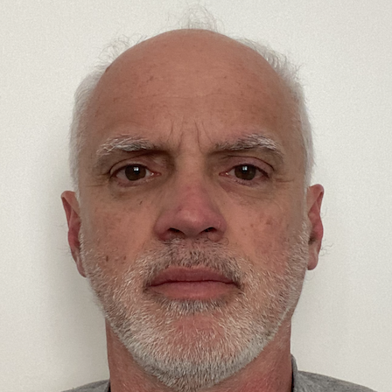

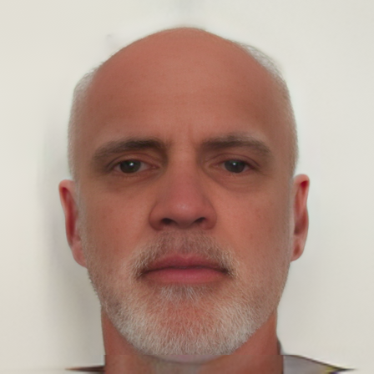

ORIGINAL
448x448
INPUT
56x56
OUTPUT
448x448

Slide 12


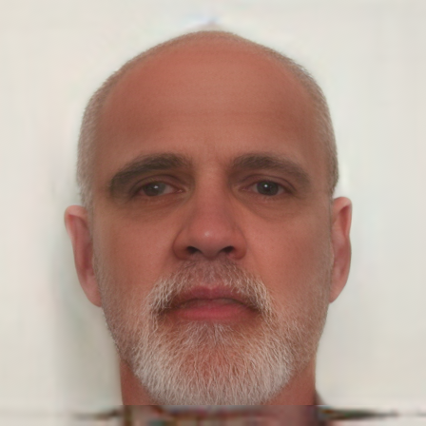

Problems with GANs for Super-Resolution
LR
56x56
LR
28x28
LR
14x14
ORIGINAL
112x112
HR
112x112
HR
112x112
HR
112x112

Slide 13
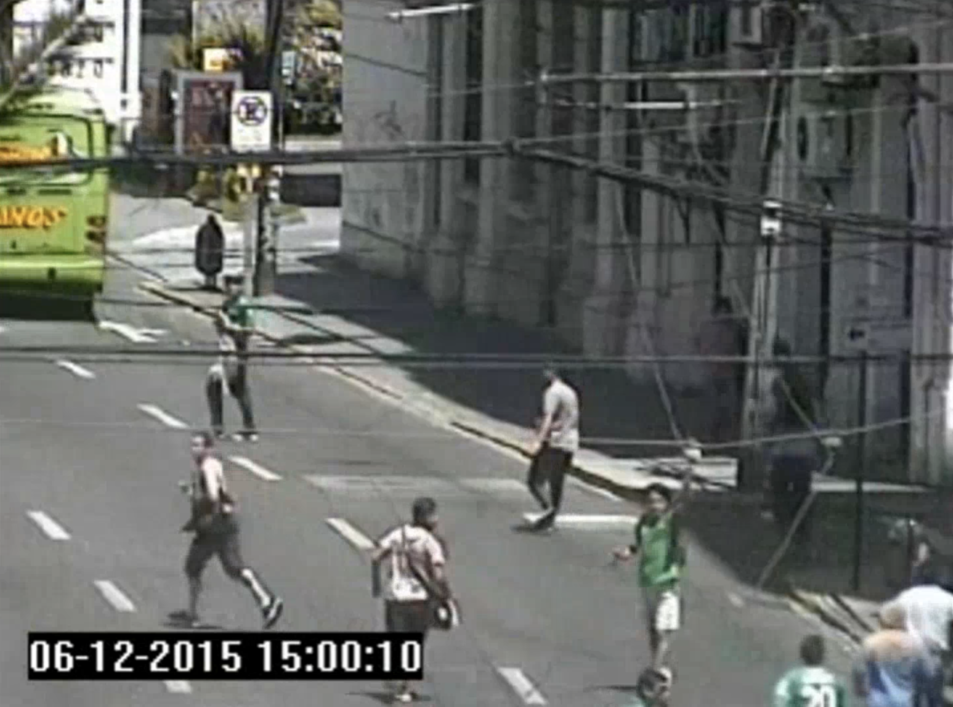
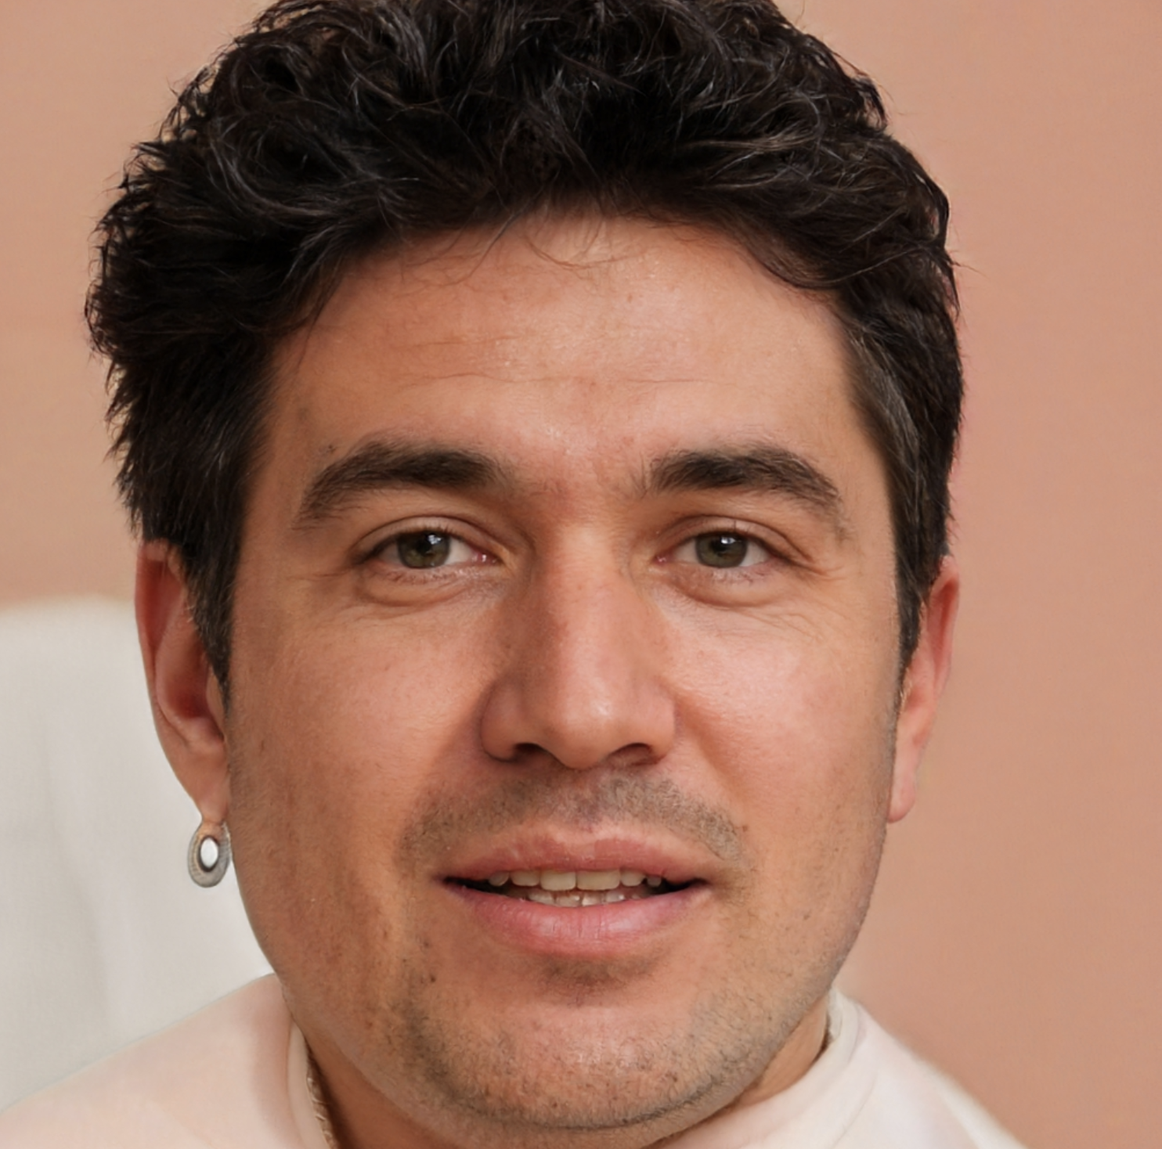
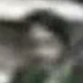
HR
1. Who is this person?
2. Is the same person?
LR

Slide 14

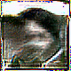
1. Who is this person?
2. Is the same person?
We don’t know. . .

Slide 15
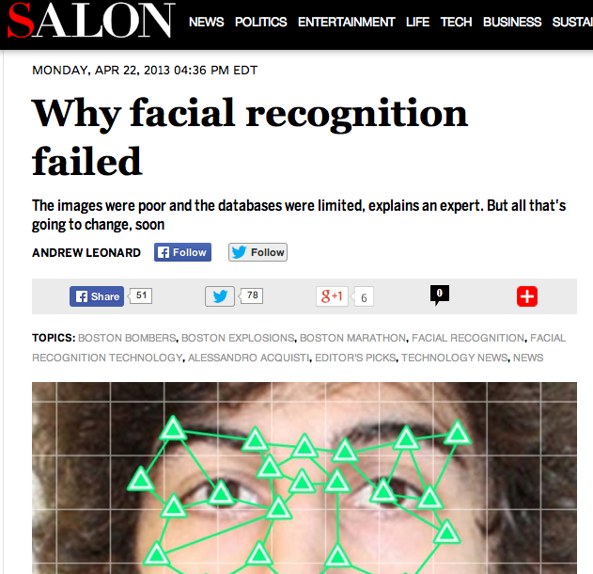
Notes:
Face recognition algorithms could not identify Boston bombing suspects

Slide 16
In contrast to conventional face recognition, unconstrained recognition involves matching a query image taken without the subject’s cooperation, and typically exhibits greater variations in confounding factors such as pose, illumination, expression, resolution, and occlusion.
J. C. Klontz and A. K. Jain (2013) A Case Study of Automated Face Recognition: The Boston Marathon Bombings Suspects, IEEE Computer.

Slide 17
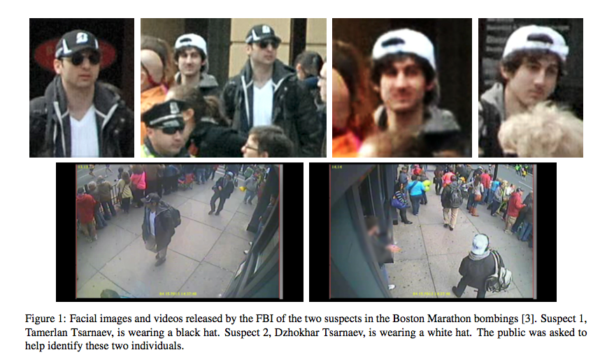

Slide 18
